Slide 1
Decision Tree and Ensemble Methods

Slide 2
Learning Objectives
Introduction to Decision tree and hands on exercise
Ensemble Methods
Bias-Variance error
Bagging concept and hands on exercise
Boosting concept and hands on exercise
Random Forest and hands on exercise
Case Study
‹#›

Slide 3
Introduction to Decision Tree
Decision Tree is used for regression and classification, more often classification.
Can be used for binary classification such as whether an applicant for loan is likely to turn into defaulter or not.
Decision tree algorithm finds the relation between the target column and the independent variables and express it as a tree structure.
It does so by binary splitting data using functions based on comparison operators on the independent columns.

Slide 4
Common measures of Impurity
Entropy
A measure of uncertainty.
Given that there are two possible outcomes for a given action.
We can express the relation between probability and impurity of target column in a mathematical form.

Slide 5
Gini Index
Is calculated by subtracting the sum of the squared probabilities of each class from one.
Perfectly classified, Gini Index would be zero
Uses squared proportion of classes.

Slide 6
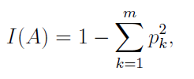
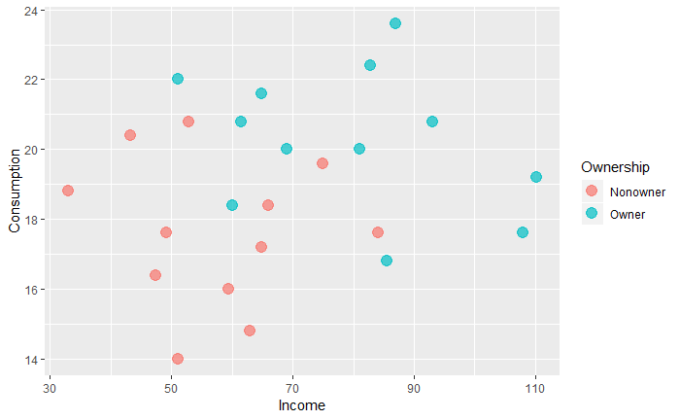
1. Calculate GINI for overall rectangle
⇒

Slide 7
2. Calculation of GINI Index for left and right rectangles
GINI index for the left & right
⇒
⇒

Slide 8
3. weighted average of impurity measures
GINI index for the left & right
⇒
⇒

Slide 9
GINI Index before & after the split
0.5
0.359
Gini Index of original rectangle
Gini index after split

Slide 10
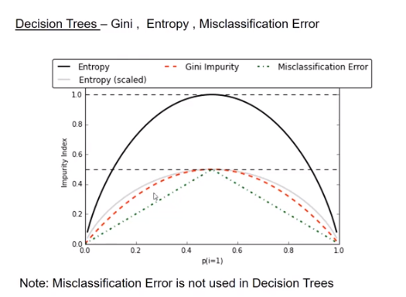

Slide 11
Hands on exercise on Decision Tree
he dataset used here is Credit data (https://archive.ics.uci.edu/ml/datasets/statlog+(german+credit+data))
Some important functions
Importing libraries
import numpy as np
import pandas as pd
from sklearn.tree import DecisionTreeClassifier
for feature in credit_df.columns : # loop through all columns in the dataframe
if credit_df[feature].dtype == ‘object’ : # only apply for columns with categorical variables
credit_df[feature] =pd.categorical(credit_df[feature]).codes

Slide 12
Splitting data into training and test sets for independent attributes
train_set = credit_df.head(500)
test_set = credit_df.tail(500)
capture the target column (“default”) into separate vectors for training set and test set
train_labels = train_set.pop(“default”)
test_labels = test_set.pop(“default”)
Invoking the decision tree classifier function
dt_model = DecisionTreeClassifier (criterion = ‘entropy’, random_state=1)
dt_model.fit(train_set, train_labels)

Slide 13
DecisionTreeClassifier (class_weight=None, criterion = ‘entropy’, max_depth=None, max_features=None, etc…)
dt_model.score(test_set, test_labels)
dt_model.score(train_set, train_labels)

Slide 14
Ensemble methods
Ensemble is a group of models that are used together for prediction both in classification and regression class.
We employ various methods to achieve this for eg: tuning hyper parameters, up-sampling/ down-sampling etc.
The motivation behind ensemble is the belief that a committee of experts working together are more likely to be accurate than individual experts.

Slide 15
Ensemble methods- Characteristics
For effective ensemble we have to ensure -
a. The models are as different from each other as possible.
b. The errors of each model should be independent.
2. The models in the ensemble
a. Are not regularized and hence each model tend to overfit prone to variance errors.
b. The variance errors across all models put together cancel out at the time of aggregation

Slide 16
Bias-Variance error
Bias are the simplifying assumptions made by a model to make the target function easier to learn.
Variance is the amount that the estimate of the target function will change if different training data was used.
The goal of any supervised machine learning algorithm is to achieve low bias and low variance. In turn the algorithm should achieve good prediction performance.
(P.S. The parameterization of machine learning algorithms is often a battle to balance out bias and variance)

Slide 17
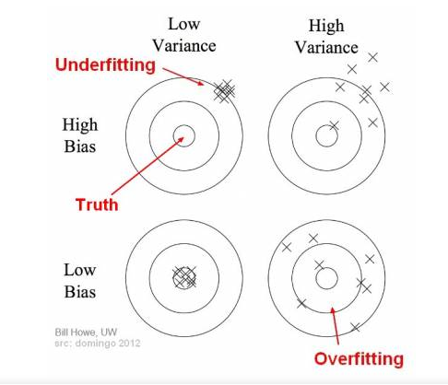
Bias and variance using bulls-eye diagram

Slide 18
Bagging concept and hands on exercise
Two families of ensemble methods are usually distinguished :
Averaging methods: The driving principle is to build several estimators independently and then to average/vote their predictors.
Boosting methods: Base estimators are built sequentially and one tries to reduce the bias of the combined estimator.

Slide 19
Bagging (Bootstrap Aggregation)
Designed to improve the stability of classification and regression models.
It reduces variance errors and helps to avoid overfitting.
Can be used with any type of machine learning model, mostly used with decision tree.
Use sampling with replacement to generate multiple samples of a given size.

Slide 20
Bagging example
Dataset
Random sample1 with replacement
Random sample2 with replacement
Random sample3 with replacement
Model1
Model2
Model3
Aggregation based on voting for classification and average for regression

Slide 21
Hands on exercise on Bagging
The dataset used here is Credit data (https://archive.ics.uci.edu/ml/datasets/statlog+(german+credit+data))
Some important functions
Importing libraries
import numpy as np
import pandas as pd
from sklearn.tree import DecisionTreeClassifier
for feature in credit_df.columns : # loop through all columns in the dataframe
if credit_df[feature].dtype == ‘object’ : # only apply for columns with categorical variables
credit_df[feature] =pd.categorical(credit_df[feature]).codes

Slide 22
Splitting data into training and test sets for independent attributes
train_set = credit_df.head(700)
test_set = credit_df.tail(300)
Invoking the decision tree classifier function using entropy
dt_model = DecisionTreeClassifier (criterion = ‘entropy’)
dt_model.fit(train_set, train_labels)
DecisionTreeClassifier (class_weight=None, criterion=‘entropy’, max_depth=None, etc..)
dt_model.score(train_set, train_labels) # Overfit due to large complex tree

Slide 23
Importing bagging classifier
from sklearn.ensemble import BaggingClassifier
bgcl = BaggingClassifier(n_estimators=50, max_samples=.8, oob_score= True)
bgcl = bgcl.fit(credit_df, credit_labels)
print(bgcl.oob_score)

Slide 24
Boosting concept
Boosting is a general ensemble method that creates a strong classifier from a number of weak classifiers.
Similar to bagging, but the learners are grown sequentially; except for the first, each subsequent learner is grown from previously grown learners.
If the learner is a Decision tree, each of the trees can be small, with just a few terminal nodes (determined by the parameter d supplied)

Slide 25
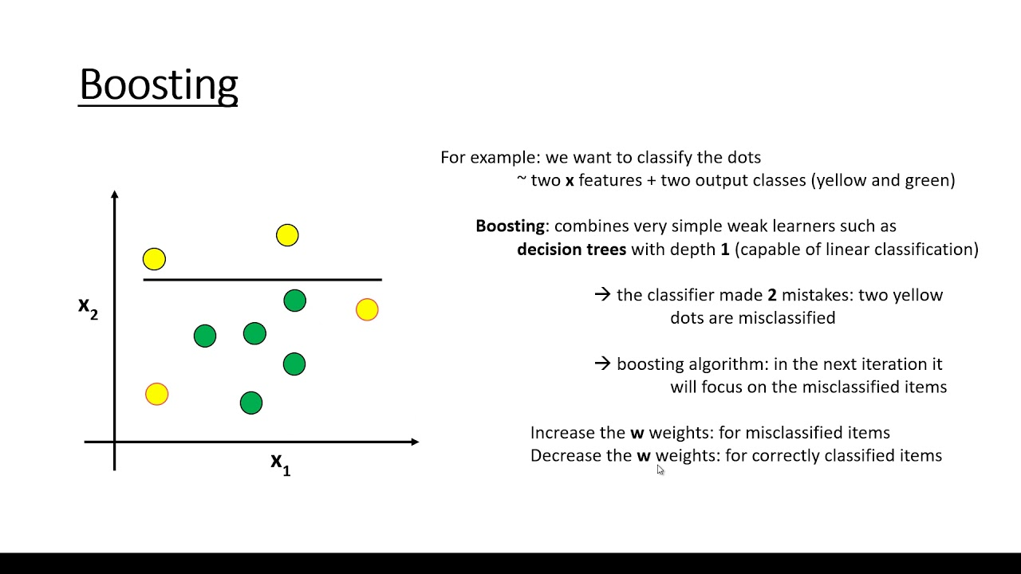

Slide 26
Types of Boosting
AdaBoosting: It is so called as the weights are re-assigned to each instance, with higher weights to incorrectly classified instance.
Gradient Boosting: By fitting new models to the residuals, the overall learner gradually improves in areas where residuals are initially high.

Slide 27
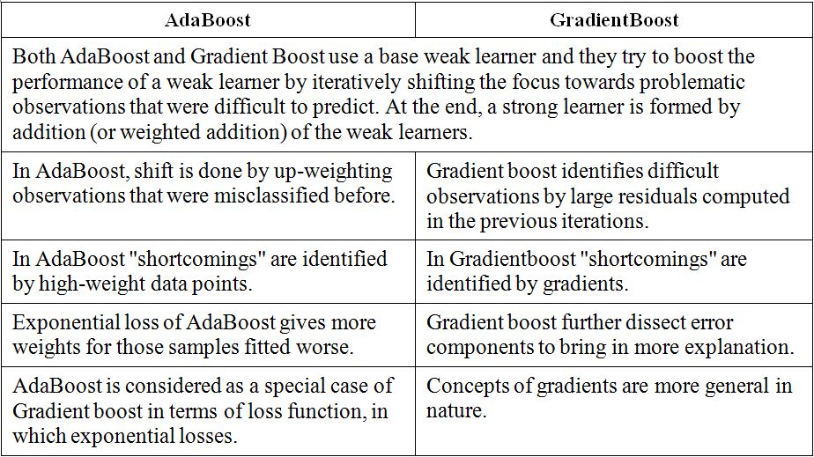
Difference between Adaboost and GradientBoost

Slide 28
Hands on exercise on Boosting
Ensemble learning – AdaBoosting
from sklearn.ensemble import AdaBoostClassifier
abcl = AdaBoostClassifier(base_estimator=dt_model, n_estimators=50)
abcl = abcl.fit(train_set, train_labels)
test_pred = abcl.predict(test_set)
abcl.score(test_set, test_labels)
Ensemble learning – GradientBoost
from sklearn.ensemble import GradientBoostingClassifier
gbcl = GradientBoostingClassifier(n_estimators=50,learning_rate=0.09, max_depth=5)

Slide 29
gbcl= gbcl.fit(train_set, train_labels)
test_pred = gbcl.predict(test_set)
gbcl.score(test_set, test_labels)

Slide 30
Random Forest
Each tree in the ensemble is built from a sample drawn with replacement (bootstrap) from the training set.
In addition, when splitting a node during the construction of a tree, the split that is chosen is no longer the best split among all the features.
Instead, the split that is picked is the best split among a random subset of the features.
Due to averaging, its variance decreases, usually more than compensating the increase in bias

Slide 31
Hands on exercise on Random Forest
Ensemble RandomForest Classifier
Import RandomForest Classifier
from sklearn.ensemble import RandomForestClassifier
rfcl = RandomForestClassifier(n_estimators = 6)
rfcl = rfcl.fit(train_set, train_labels)
test_pred = rfcl.predict(test_set)
rfcl.score(test_set, test_labels)

Slide 32
Case Study - Wine quality production
Context
The dataset is related to red variants of the Portuguese “Vinho Verde” wine. Due to privacy and logistic issues, only physicochemical (inputs) and sensory (output) variables are available ( eg: there is no data about grape types, wine brand, wine selling price, etc.)
These datasets can be viewed as classification or regression tasks. The classes are ordered and not balanced (eg, there are much more normal wines than excellent or poor ones).

Slide 33
Dataset
https://www.kaggle.com/uciml/red-wine-quality-cortez-et-al-2009
Problem Statement
Wine Quality Prediction - Here, we will apply a method of assessing wine quality using a Decision Tree, and test it against the wine-quality dataset from the UC Irvine machine learning repository. The wine dataset is a classic and very easy multi-class classification dataset.

Slide 34
Data Attributes
Fixed Acidity 10. Sulphates
Volatile acidity 11. Alcohol
Citric acid 12. Quality
Residual sugar
Chlorides
Free sulphur dioxide
Total sulphur dioxide
Density
pH

Slide 35
Steps to follow
Import all necessary libraries and load the data
Print the descriptive statistics of each & every column using describe() function
Using univariate analysis check the individual attributes for their basic statistic such as central values, spread, tails etc.
Use pairplots and correlation method to observe the relationship between different variables and state your insights.
Split the wine_df into training and test set in the ratio of 70:30 (Training:Test) based on dependent and independent variables.
Create the decision tree model using “entropy” method of finding the split columns and fit it to training data.

Slide 36
7. Print the accuracy of the model & print the confusion matrix
8. Regularize the decision tree by limiting the max. depth of trees and print the accuracy.
9. Apply the Random forest model and print the accuracy of Random forest Model
10. Apply Adaboost Ensemble Algorithm for the same data and print the accuracy.
11. Apply Bagging Classifier Algorithm and print the accuracy.
12. Apply GradientBoost Classifier Algorithm for the same data and print the accuracy

Slide 37


Questions?

